Slide 1
Sprint Review
Basics of CSV, JSON & XML
By: Tori Larson

Slide 2
Birthday Data in R and Python.
Upload a CSV file?

Slide 3
Comma,Separated,Values
FirstName,LastName,Birthday
Tori,Larson,5/26/2017
Ben,Trevino,4/14/2017
Justine,Espiritu,8/8/2017

Slide 4
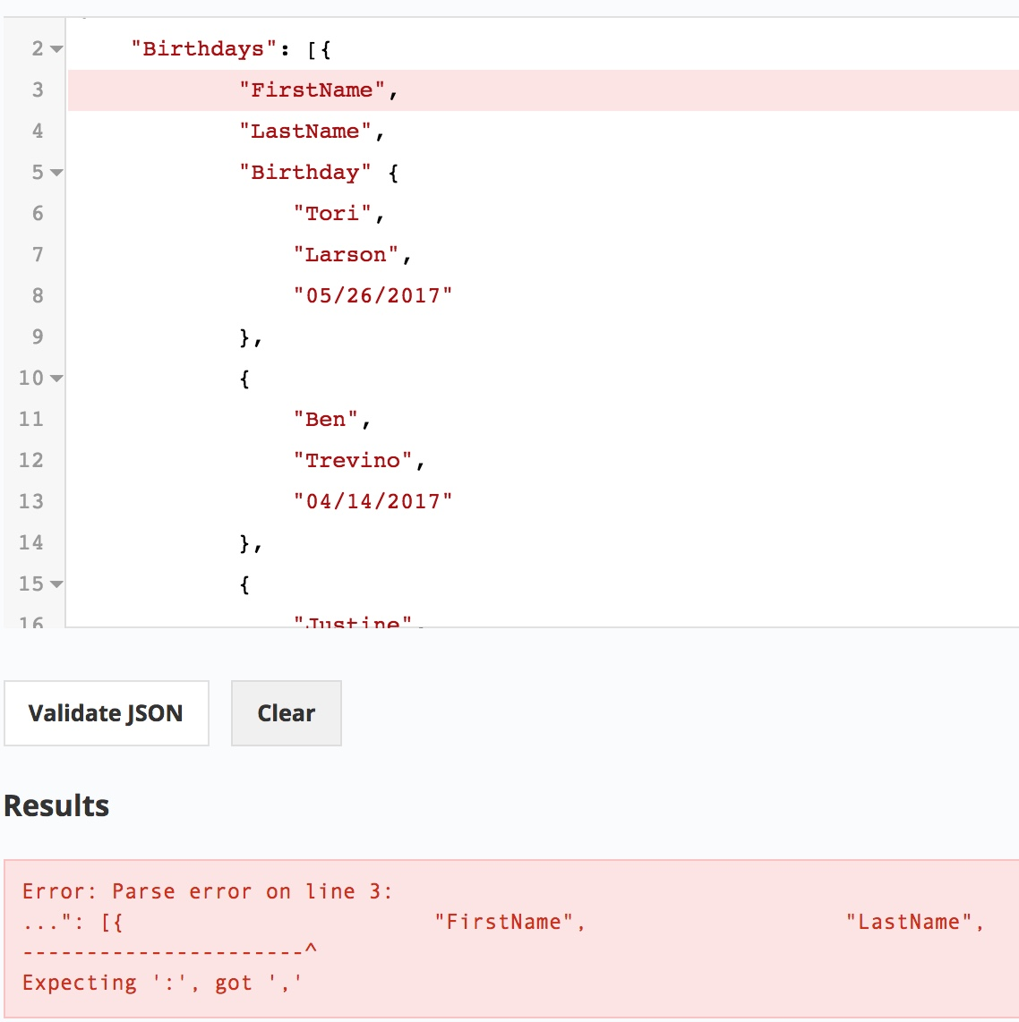
JSON
Exactly like CSV…..right?
{"Birthdays":[
{"FirstName", "LastName", "Birthday" {"Tori","Larson","05/26/2017"},
{"Ben", "Trevino","04/14/2017"}, {"Justine","Espiritu","07/28/2017"}
]}
Validate you JSON code here:
https://jsonlint.com/

Slide 5
JSON FINAL
{"Birthdays":[
{"FirstName": "Tori", "LastName": "Larson", "Birthday":"05/26/2017"},
{"FirstName": "Ben", "LastName": "Trevino", "Birthday": "04/14/2017"}, {"FirstName": "Justine", "LastName": "Espiritu", "Birthday": "07/28/2017"}
]}

Slide 6
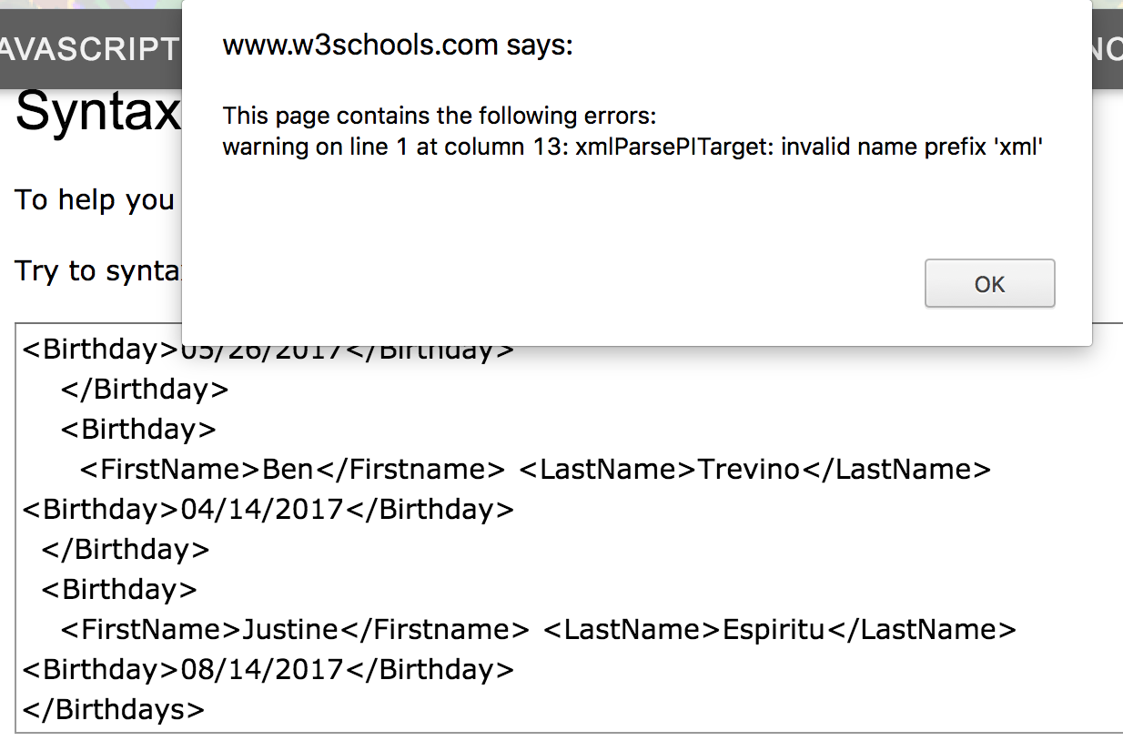
XML
<?xmlversion="1.0" encoding="UTF-8"?>
<Birthdays>
<Birthday>
<FirstName>Tori</Firstname> <LastName>Larson</LastName> <Birthday>05/26/2017</Birthday></Birthday>
<Birthday>
<FirstName>Ben</Firstname> <LastName>Trevino</LastName> <Birthday>04/14/2017</Birthday>
</Birthday>
<Birthday>
<FirstName>Justine</Firstname> <LastName>Espiritu</LastName> <Birthday>08/14/2017</Birthday>
</Birthdays>
https://www.w3schools.com/xml/xml_validator.asp

Slide 7
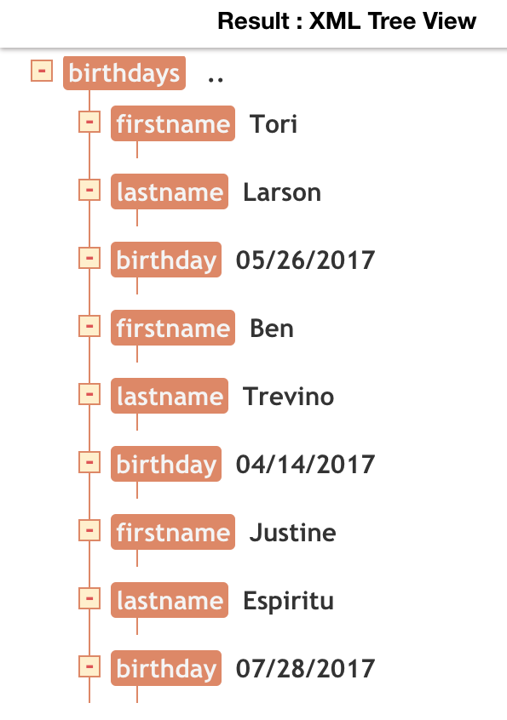
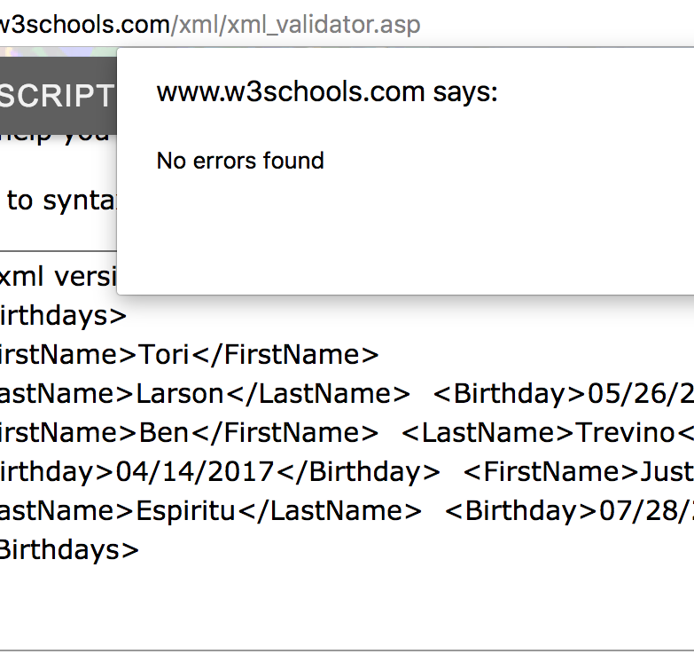
XML Tree
<?xml version="1.0" encoding= "UTF-8"?>
<Birthdays>
<FirstName>Tori</FirstName>
<LastName>Larson</LastName> <Birthday>05/26/2017</Birthday> <FirstName>Ben</FirstName> <LastName>Trevino</LastName> <Birthday>04/14/2017</Birthday> <FirstName>Justine</FirstName> <LastName>Espiritu</LastName> <Birthday>07/28/2017</Birthday>
</Birthdays>
https://codebeautify.org/xmlviewer

Slide 8
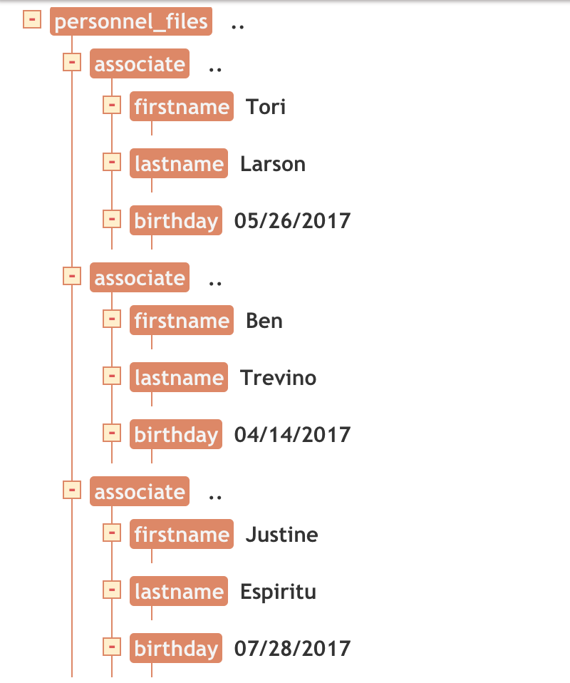
XML FINAL ATTEMPT WITH TREE
<?xml version="1.0" encoding= "UTF-8"?> <Personnel_Files>
<Associate>
<FirstName>Tori</FirstName> <LastName>Larson</LastName> <Birthday>05/26/2017</Birthday>
</Associate>
<Associate>
<FirstName>Ben</FirstName> <LastName>Trevino</LastName> <Birthday>04/14/2017</Birthday>
</Associate>
<Associate>
<FirstName>Justine</FirstName> <LastName>Espiritu</LastName> <Birthday>07/28/2017</Birthday>
</Associate>
</Personnel_Files>

Slide 9
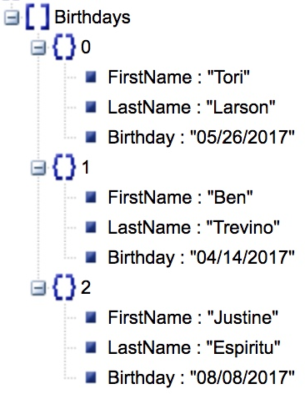
JSON TREE
{"Birthdays":[
{"FirstName": "Tori", "LastName": "Larson", "Birthday":"05/26/2017"},
{"FirstName": "Ben", "LastName": "Trevino", "Birthday": "04/14/2017"}, {"FirstName": "Justine", "LastName": "Espiritu", "Birthday": "07/28/2017"}
]}

Slide 10
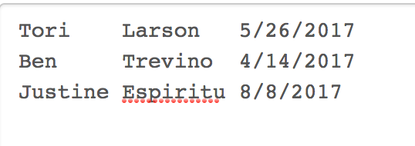

Slide 11
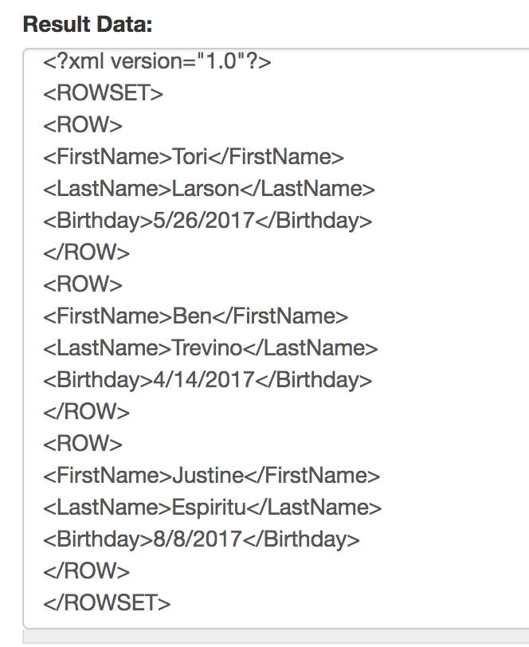
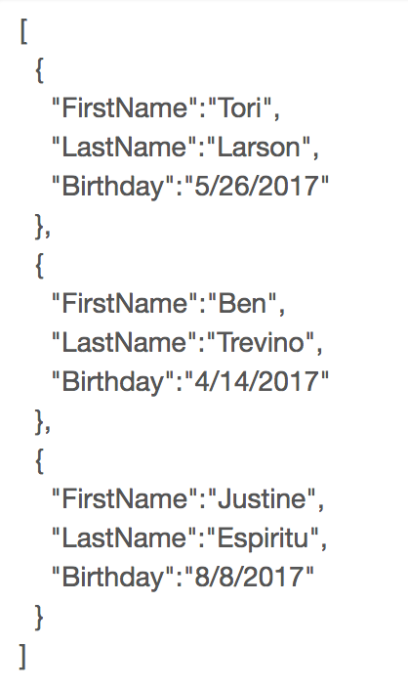
XML
JSON
<?xml version="1.0" encoding= "UTF-8"?> <Personnel_Files>
<Associate>
<FirstName>Tori</FirstName>
<LastName>Larson</LastName> <Birthday>05/26/2017</Birthday>
</Associate>
<Associate>
<FirstName>Ben</FirstName> <LastName>Trevino</LastName> <Birthday>04/14/2017</Birthday>
</Associate>
<Associate>
<FirstName>Justine</FirstName> <LastName>Espiritu</LastName> <Birthday>07/28/2017</Birthday>
</Associate>
</Personnel_Files>
{"Birthdays":[ {
"FirstName": "Tori", "LastName": "Larson", "Birthday":"05/26/2017”
},
{
"FirstName": "Ben", "LastName": "Trevino", "Birthday": "04/14/2017”
},
{
"FirstName": "Justine", "LastName": "Espiritu", "Birthday": "07/28/2017”
}
]}
http://www.becsv.com/csv-json.php

Slide 12
The End

